Slide 3
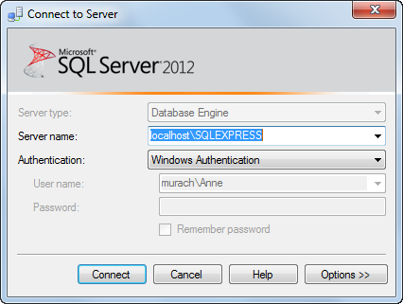

Slide 4
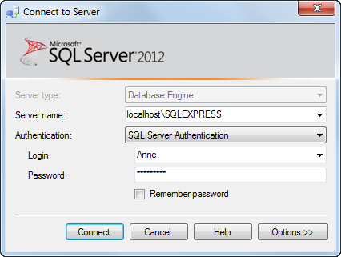
SQL Server Logins for NEIT Server
Username:
"SE133_" + First Initial + Last Name
PW: Student ID
DB Name: Same as username
SQL Server Address:
sql.neit.edu\studentsqlserver,4500

Slide 5
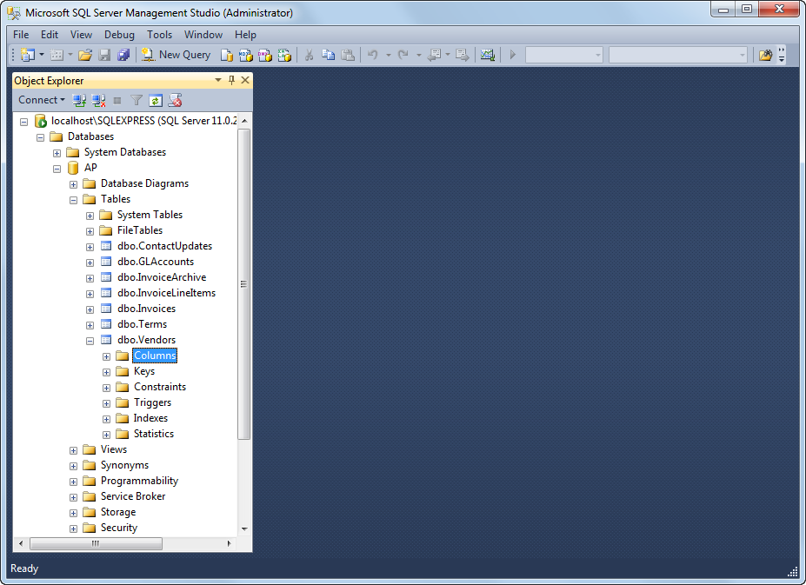

Slide 9
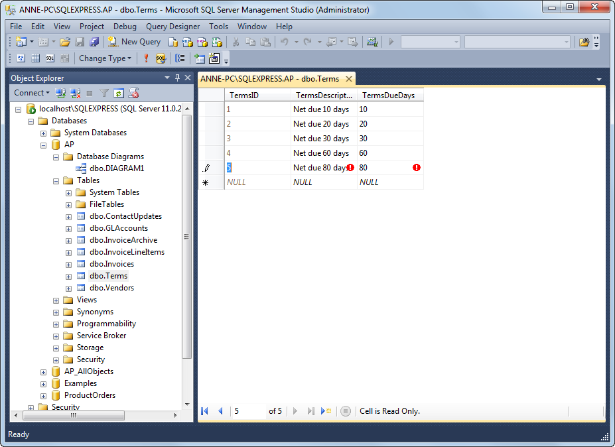

Slide 11
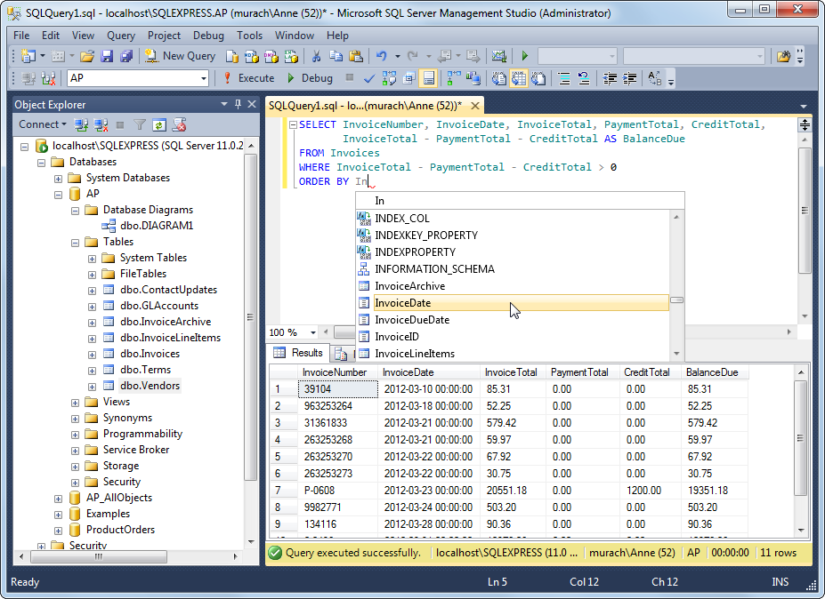

Slide 12
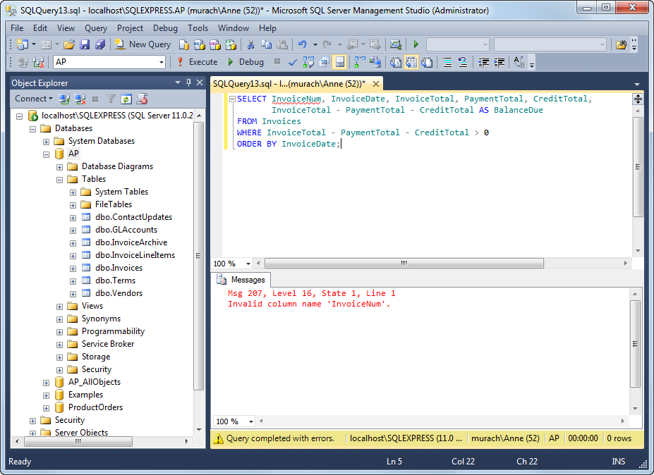

Slide 16
Brainstorming our Cars Table
What attributes would you be interested in when looking for a Car?
Car Attributes | Info? Options? | DB Data Type
Notes:
Okay…Grab a piece of paper and a pencil. Now…Think about a time that you either were looking to buy a car. What attributes (or features) did you want to know about the cars you were looking to buy? What types of questions do you think your friends might ask if you got a new car and they have not seen it yet ? Write them down….Please pause the video or slide show here so that you can brainstorm the car features. Then come back to continue.

Slide 17
Brainstorming our Cars Table
What attributes would you be interested in when looking for a Car?
Car Attributes | Info? Options? | DB Data Type
Year (2018)
Make (Honda)
Model (Civic)
Notes:
Here are a couple….just in case you were having a hard time. Take a moment to try thinking a little more, then you can continue.

Slide 18
Brainstorming our Cars Table
What attributes would you be interested in when looking for a Car?
Car Attributes | Info? Options? | DB Data Type
Year (2018)
Make (Honda)
Model (Civic)
Mileage (10273)
Doors (2,3,4,5)
Cylinders (4,6,8)
Liters (1.6, 1.8, 2.2)
Trans (Auto, Manual)
Notes:
How does this look?

Slide 19
Brainstorming our Cars Table
What attributes would you be interested in when looking for a Car?
Car Attributes | Info? Options? | DB Data Type
Year (2018)
Make (Honda)
Model (Civic)
Mileage (10273)
Doors (2,3,4,5)
Cylinders (4,6,8)
Liters (1.6, 1.8, 2.2)
Trans (Auto, Manual)
VIN
Car_ID
Notes:
Now the car comes with its own VIN, but we are also adding our own ID for the car….just in case the car comes in and they have not filled in the VIN# yet.

Slide 20
Brainstorming our Cars Table
What attributes would you be interested in when looking for a Car?
Car Attributes | Info? Options? | DB Data Type
Year (2018)
Make (Honda)
Model (Civic)
Mileage (10273)
Doors (2,3,4,5)
Cylinders (4,6,8)
Liters (1.6, 1.8, 2.2)
Trans (Auto, Manual)
VIN
Car_ID
Price
Notes:
OOOPSSS….I ALMOST FORGOT!!!! Cars have prices/costs. Now let’s think about they type of data we might be using. Please pause and write down your ideas or examples.

Slide 21
Brainstorming our Cars Table
What attributes would you be interested in when looking for a Car?
Car Attributes | Info? Options? | DB Data Type
Year (2018) | A Year, maybe a date
Make (Honda) | String of text
Model (Civic) | String of text
Mileage (10273) | A large integer
Doors (2,3,4,5) | A small integer
Cylinders (4,6,8) | ???
Liters (1.6, 1.8, 2.2) | Float
Trans (Auto, Manual) | Character A/M
VIN | ???
Car_ID | Large integer/key
Price | ???
Active | Y/N or T/F
Notes:
Here is what I am thinking…Oopps….maybe we also want an Active field to mark whether a Car is for sale or on hold right now. What about the ???’s.

Slide 22
Brainstorming our Cars Table
What attributes would you be interested in when looking for a Car?
Car Attributes | Info? Options? | DB Data Type
Year (2018) | A Year, maybe a date | DateTime (9/1/????)
Make (Honda) | String of text | NVarChar(20)
Model (Civic) | String of text | ???
Mileage (10273) | A large integer | Big Int
Doors (2,3,4,5) | A small integer | ???
Cylinders (4,6,8) | A small integer | Int
Liters (1.6, 1.8, 2.2) | Real Number | Float
Trans (Auto, Manual) | String Auto/Manual | ???
VIN | String of Text | ???
Car_ID | Large integer/key | ???
Price | Real number | ???
Active | Y/N or T/F | ???
Notes:
I bolded my replacements for the ???’s. Did you pick the same thing? If not, you may have a correct idea or maybe wrong because I know something about the data that you have not thought of yet. Please feel free to post your questions in the discussion board for this week. Now, let’s convert this to the actual data type within SQL Server. Pause the video or presentation now and see if you can fill in the lines with the ???’s.

Slide 23
Brainstorming our Cars Table
What attributes would you be interested in when looking for a Car?
Car Attributes | Info? Options? | DB Data Type
Year (2018) | A Year, maybe a date | DateTime (9/1/????)
Make (Honda) | String of text | NVarChar(20)
Model (Civic) | String of text | NVarChar(20)
Mileage (10273) | A large integer | Big Int
Doors (2,3,4,5) | A small integer | Int
Cylinders (4,6,8) | A small integer | Int
Liters (1.6, 1.8, 2.2) | Real Number | Float
Trans (Auto, Manual) | String Auto/Manual(6) | NVarChar(6)
VIN | String of Text (17) | NVarChar(17)
Car_ID | Large integer/key | BigInt, Identity, PK
Price | Real number | Float
Active | Y/N or T/F | Bit
Notes:
Now we have our Database Data Types. Why are we using NVarChar instead of VarChar? What do the #’s in parenthesis represent? Please let me know the questions you have. Our next step is to Build this table in our databases and populate the table with some sample data.

Slide 25
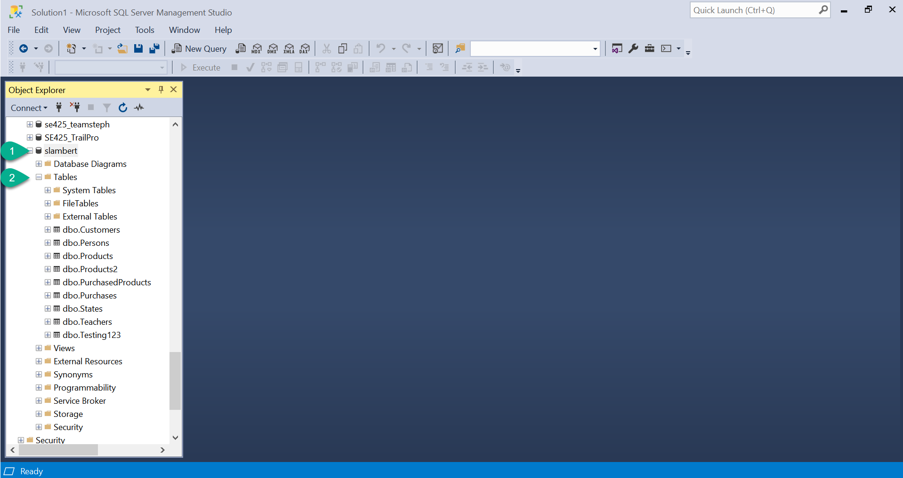

Slide 26
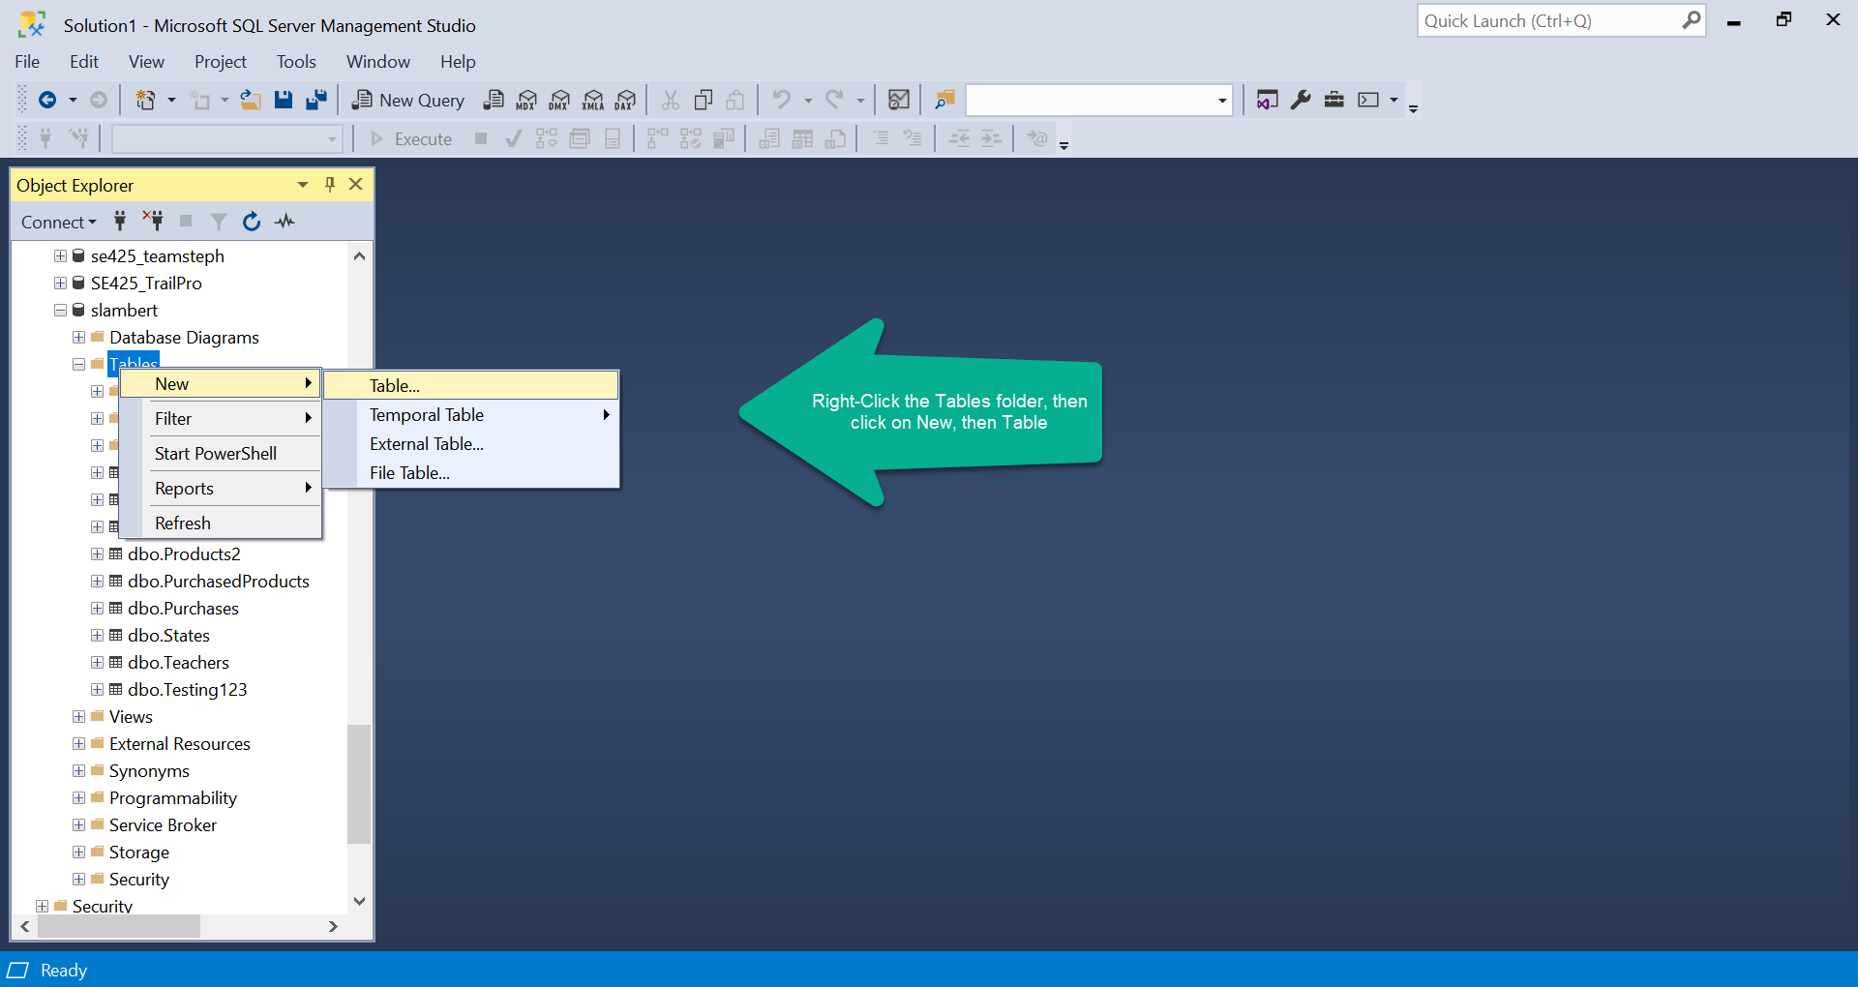

Slide 27
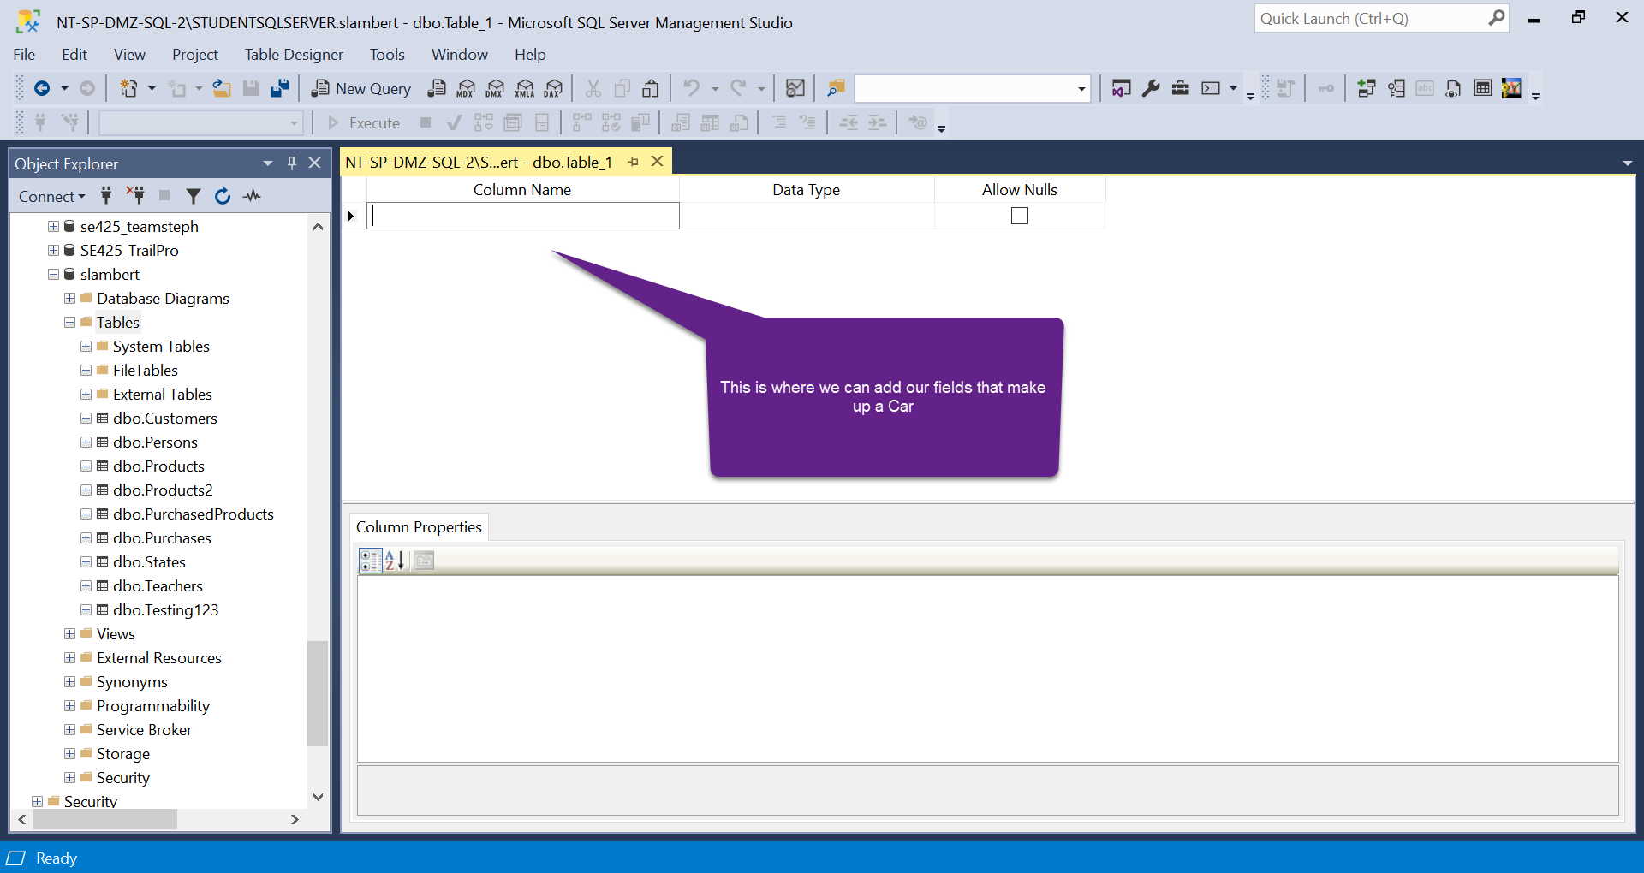

Slide 28
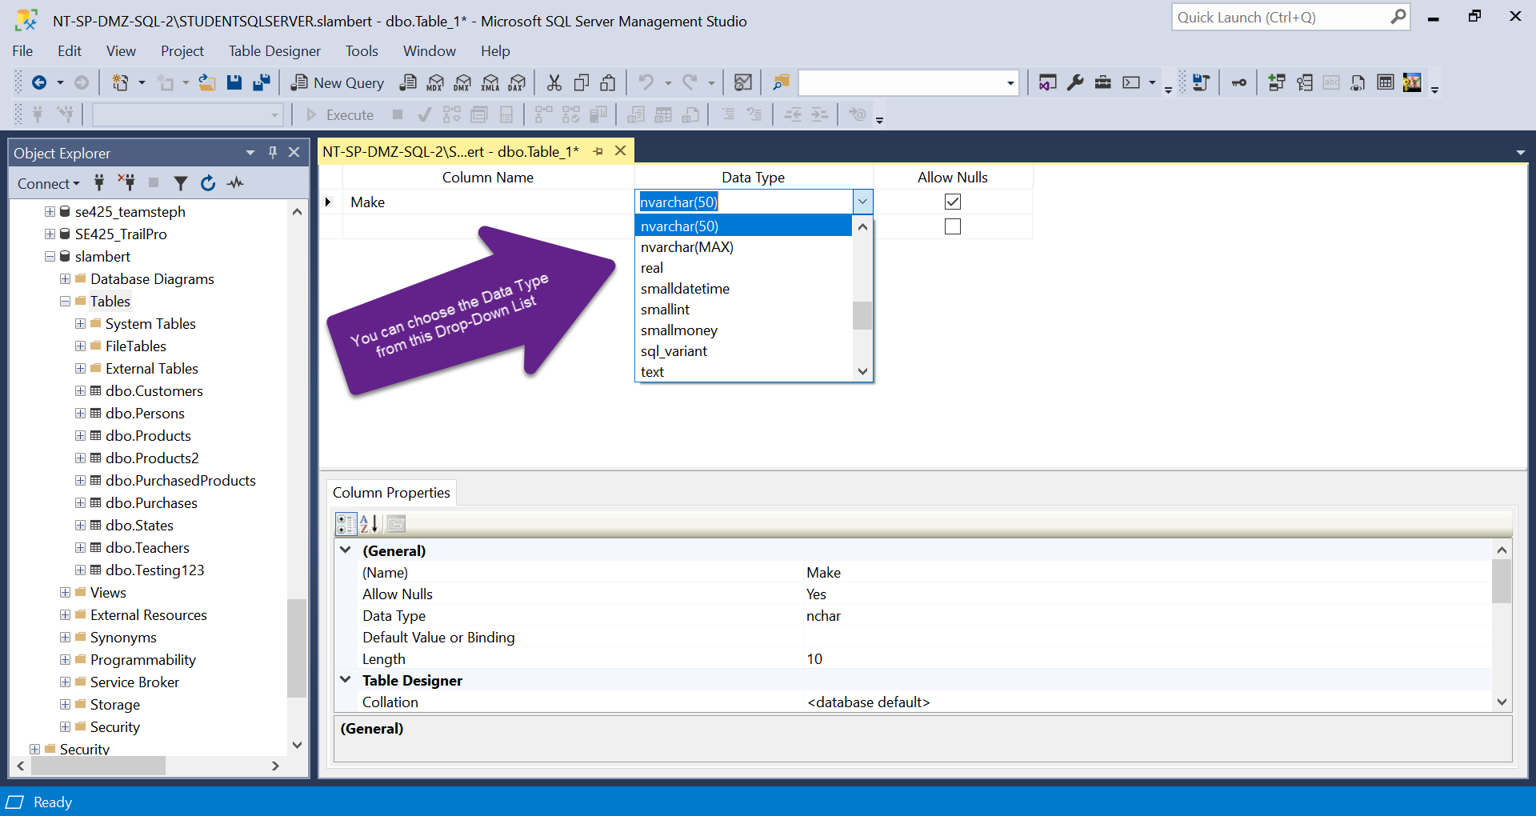

Slide 29
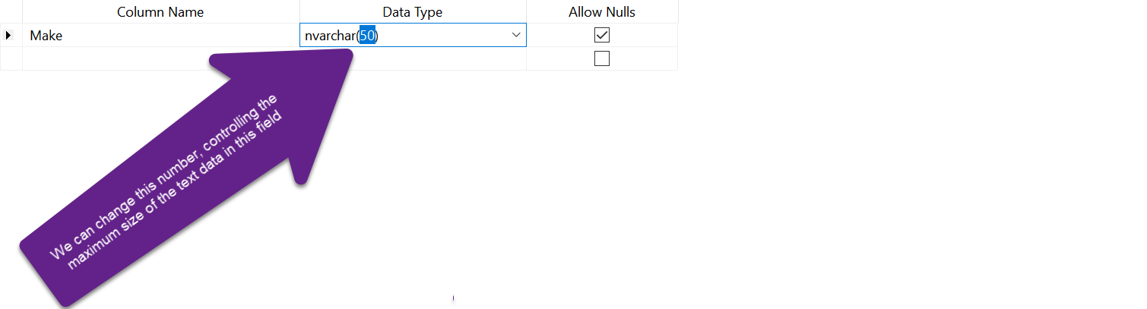

Slide 30
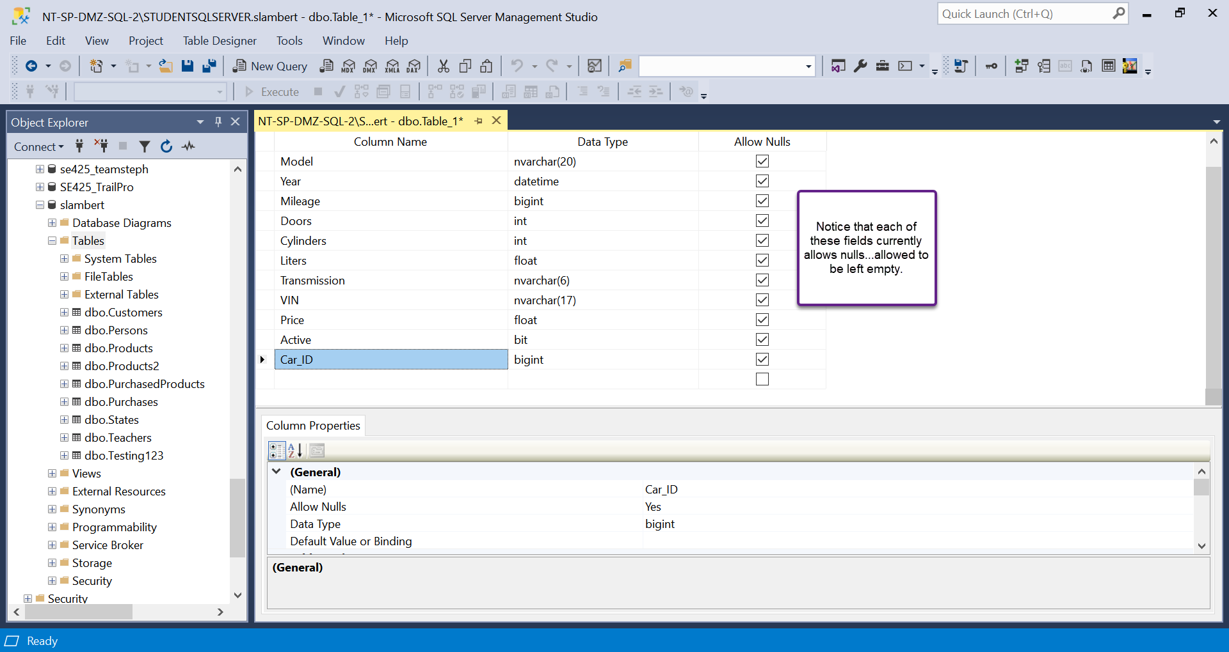

Slide 31
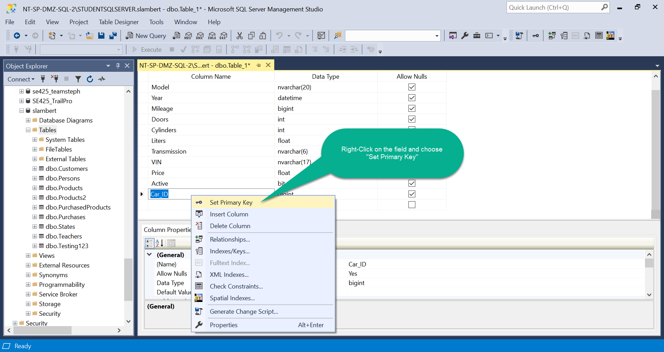

Slide 32
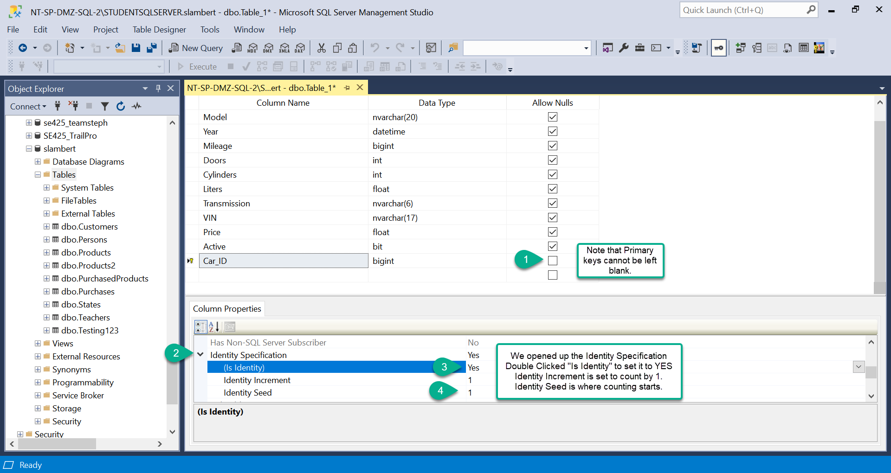

Slide 33
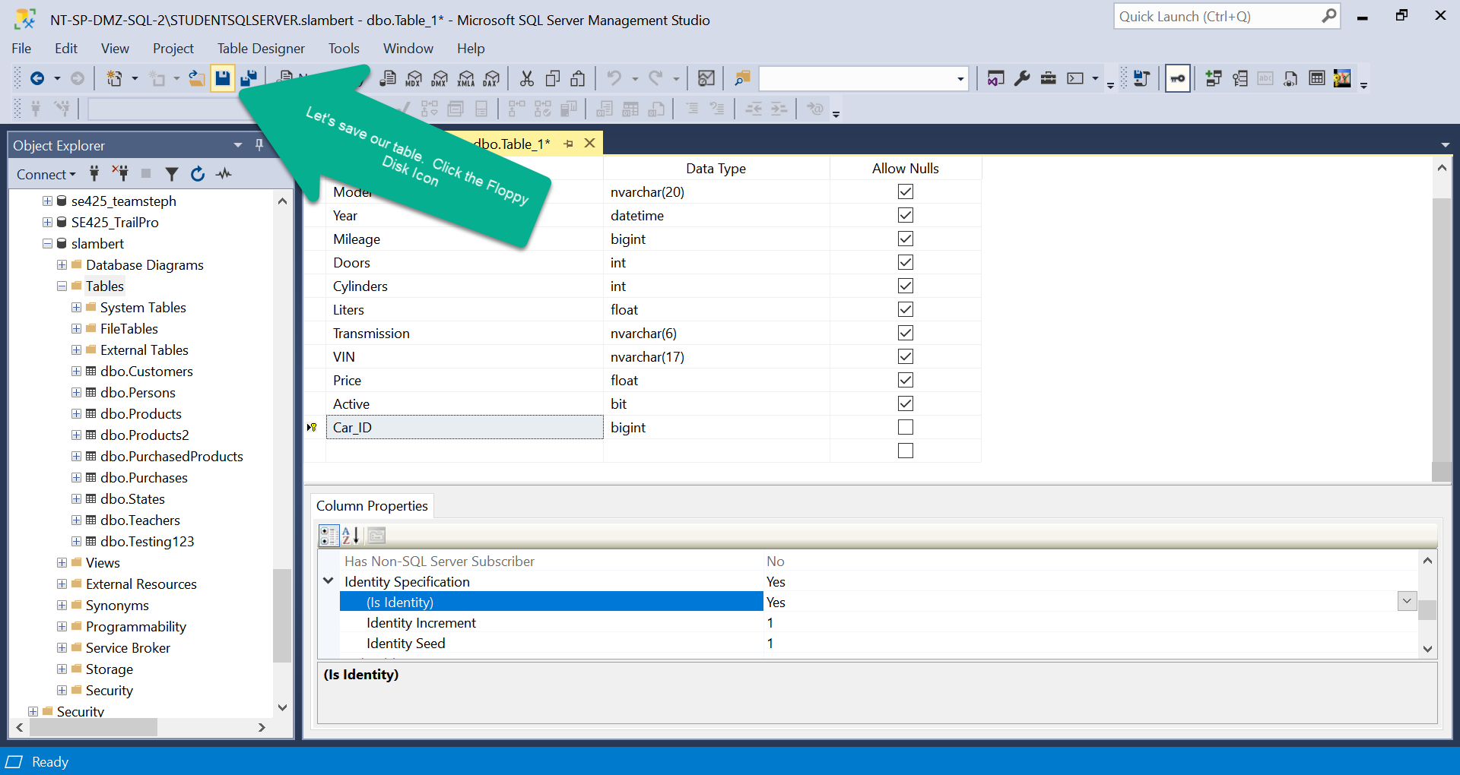

Slide 34
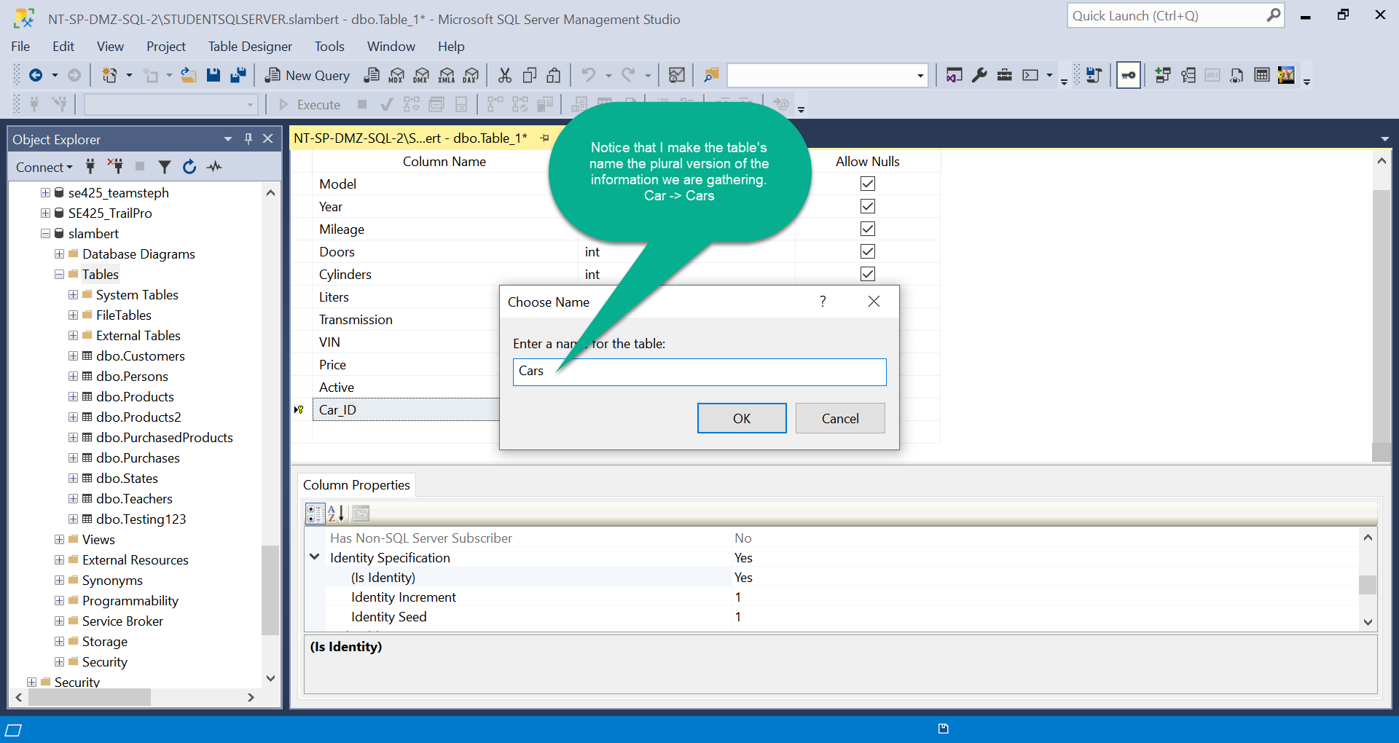

Slide 35
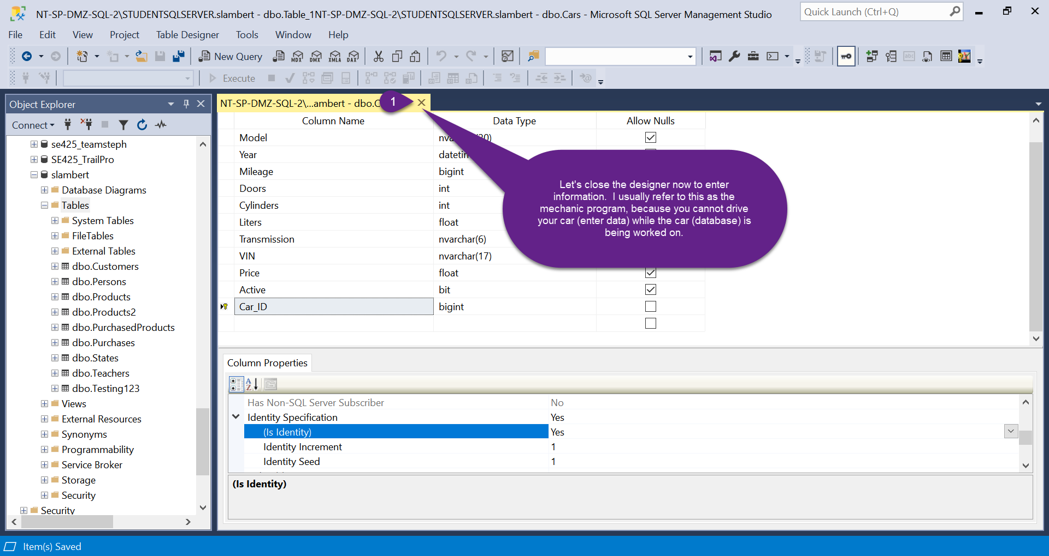

Slide 36
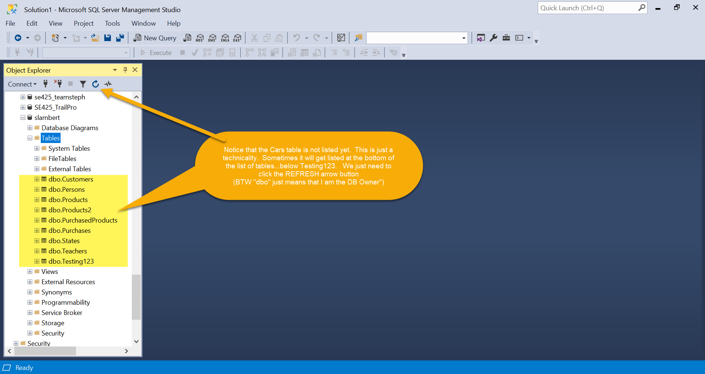

Slide 37
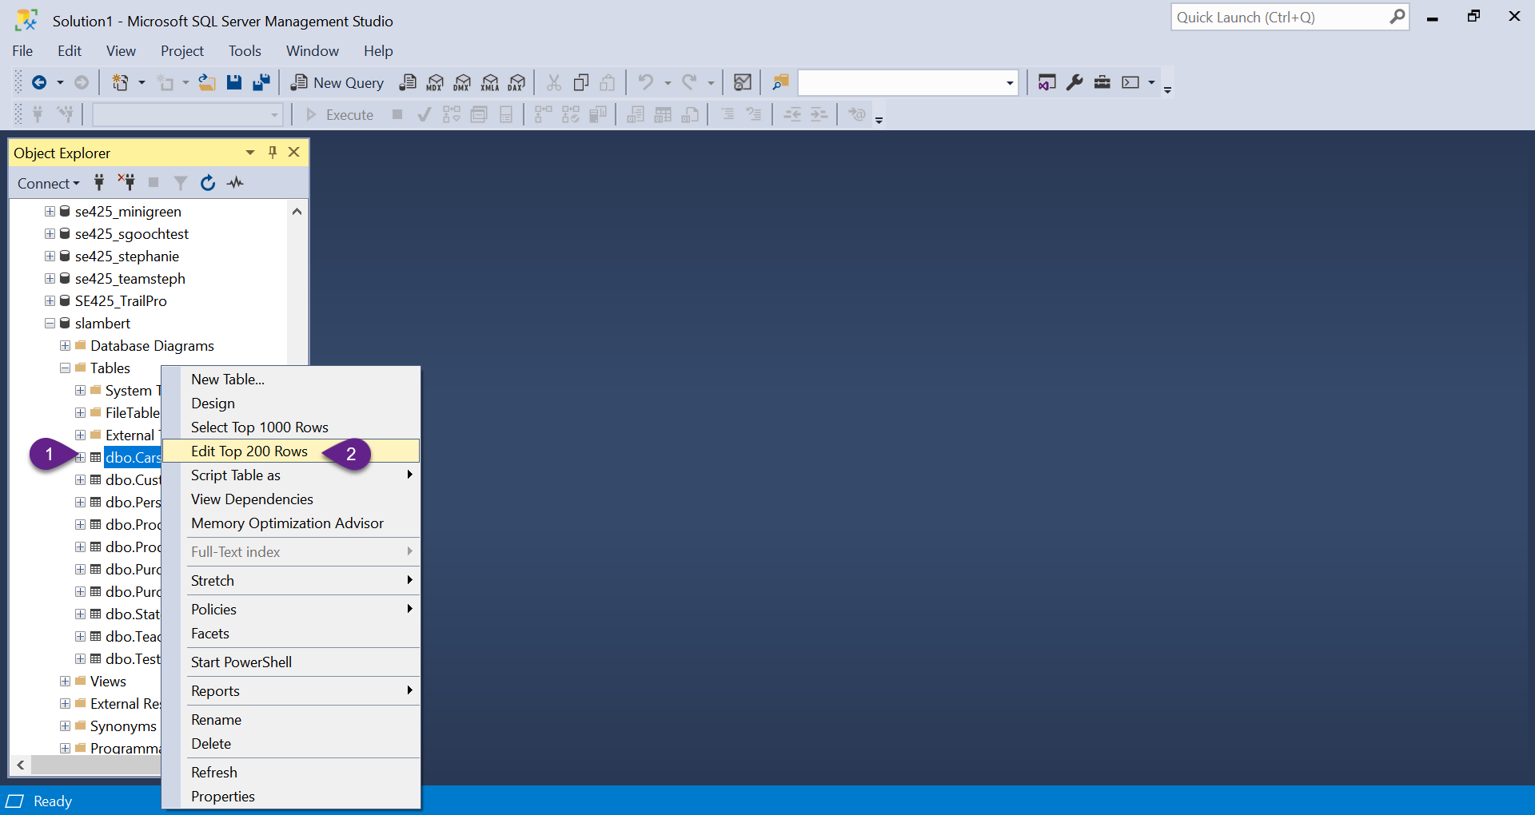

Slide 38
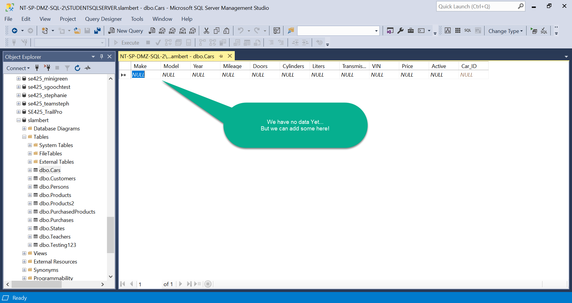

Slide 39
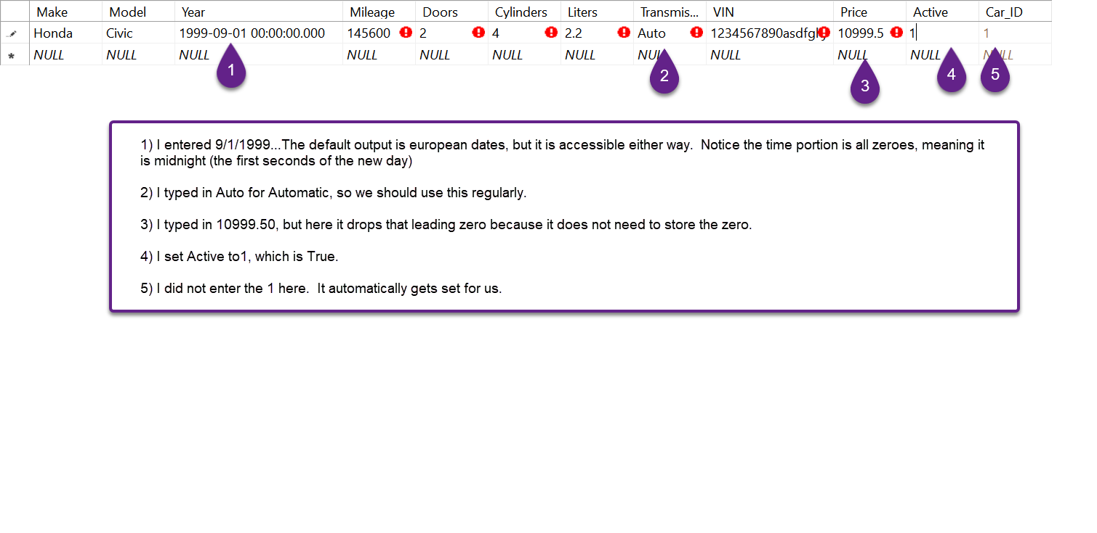

Slide 40
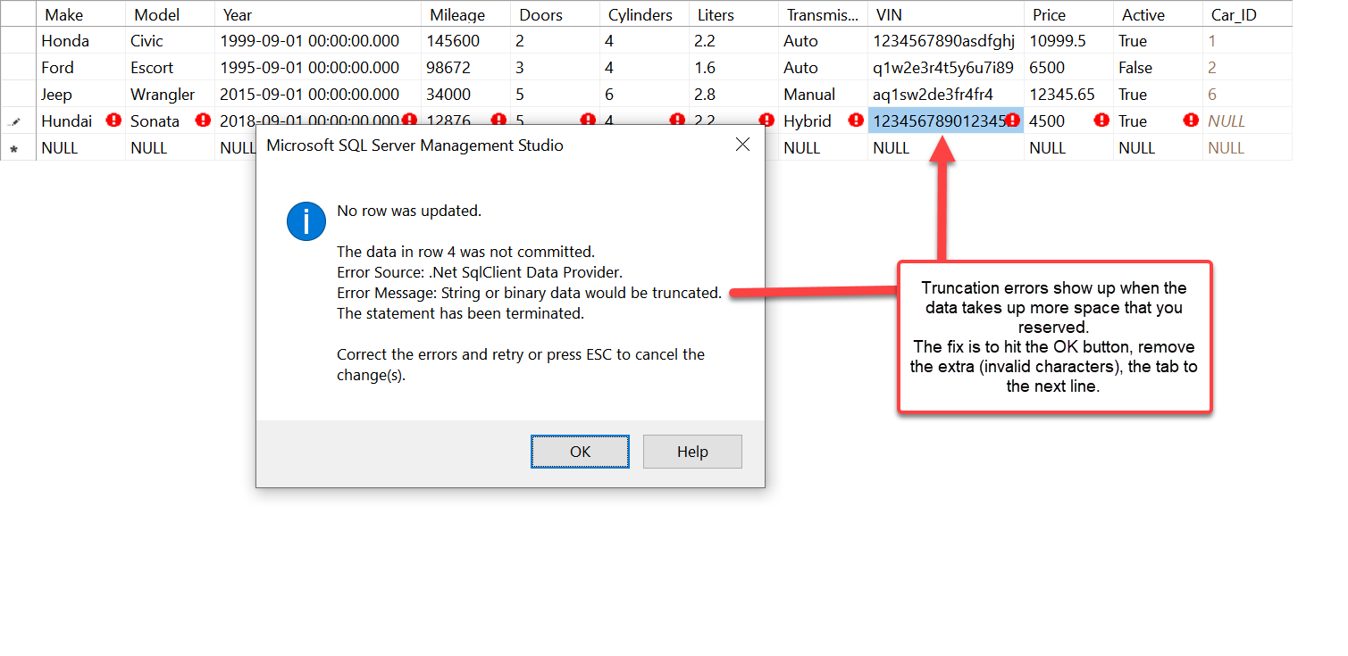

Slide 41
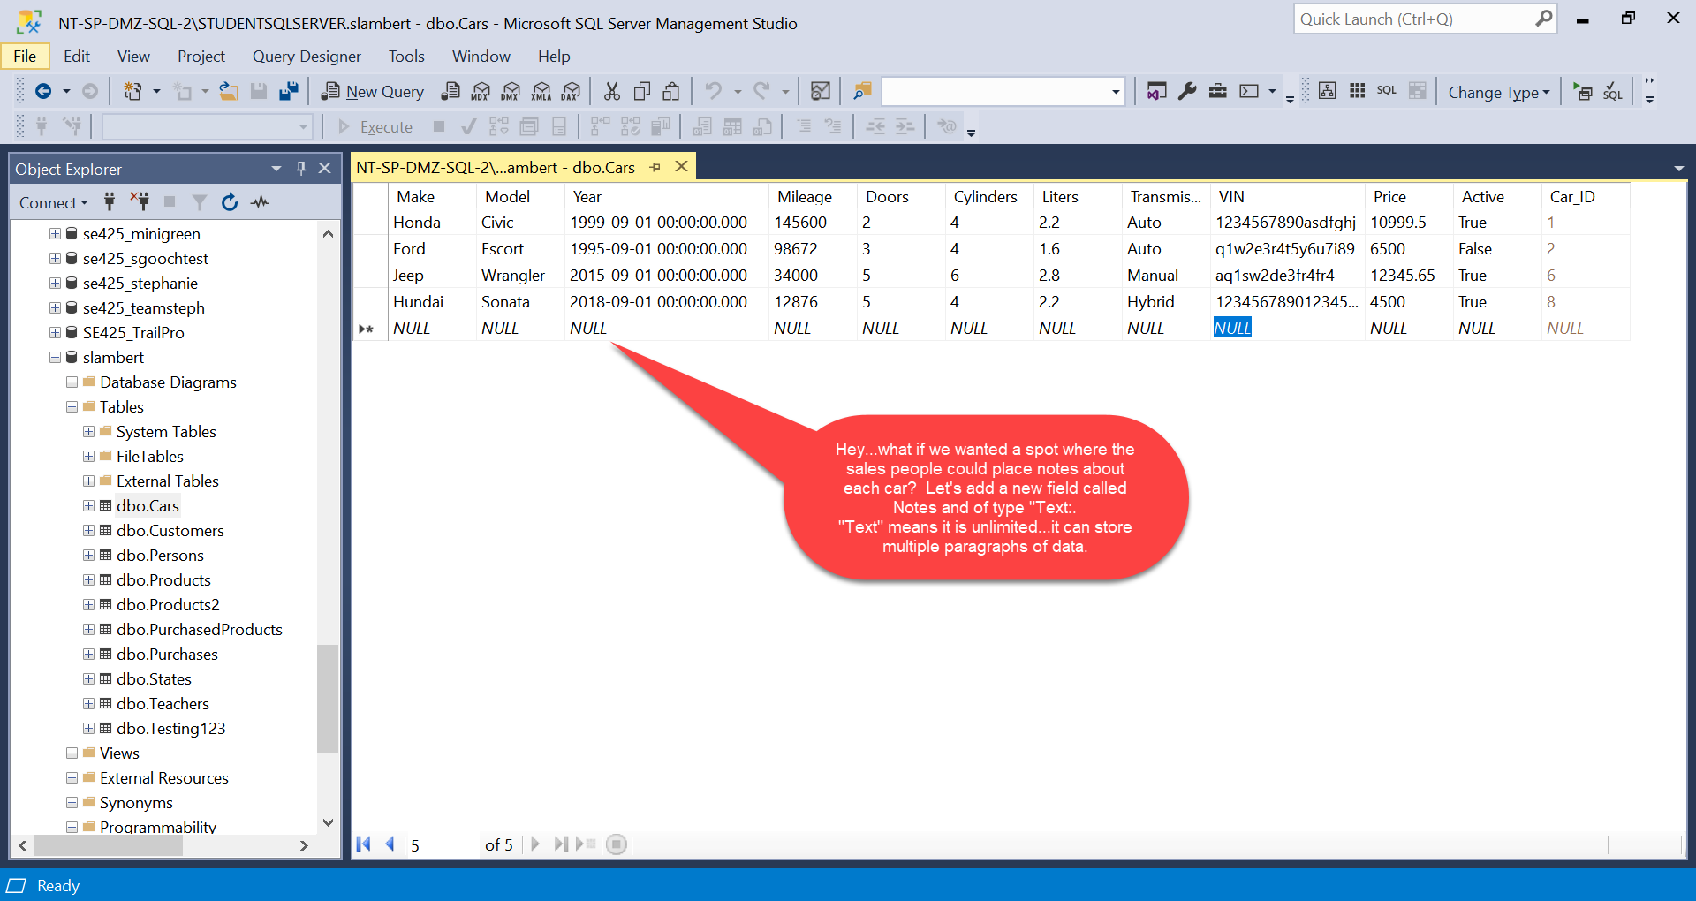

Slide 42
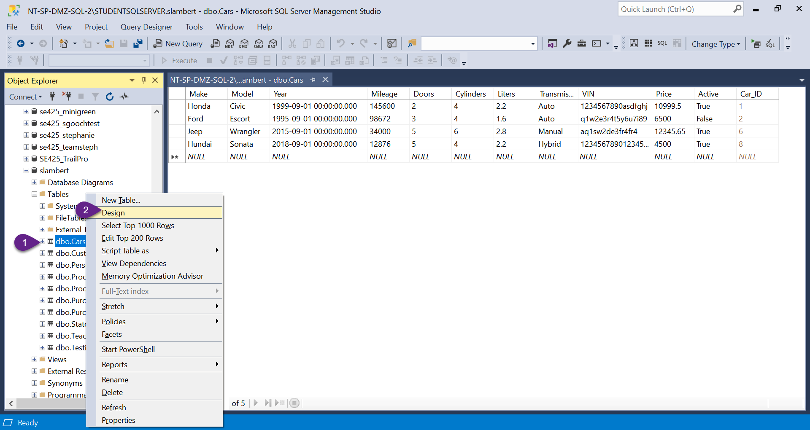

Slide 43
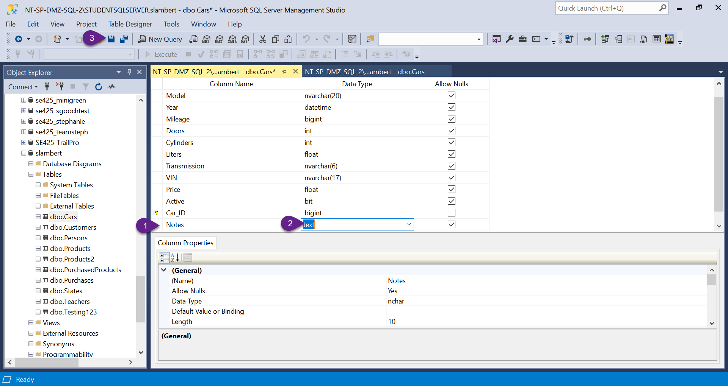

Slide 44
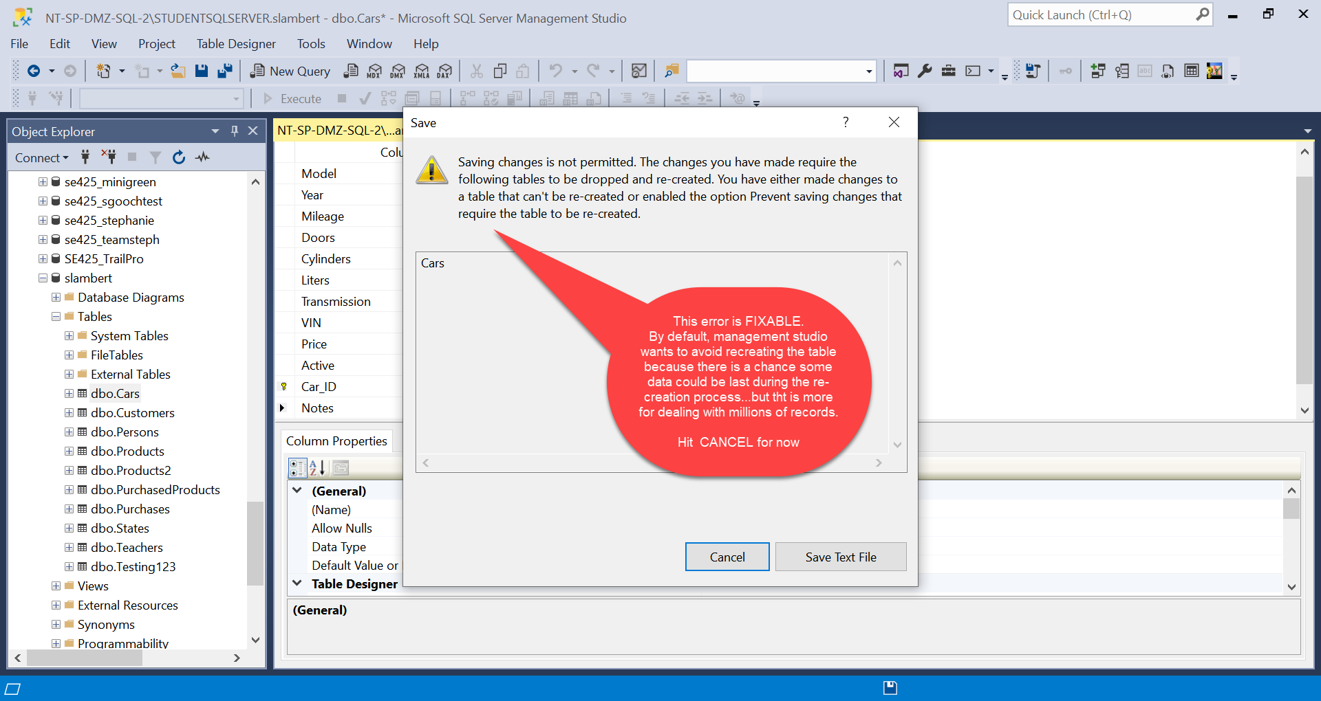

Slide 45
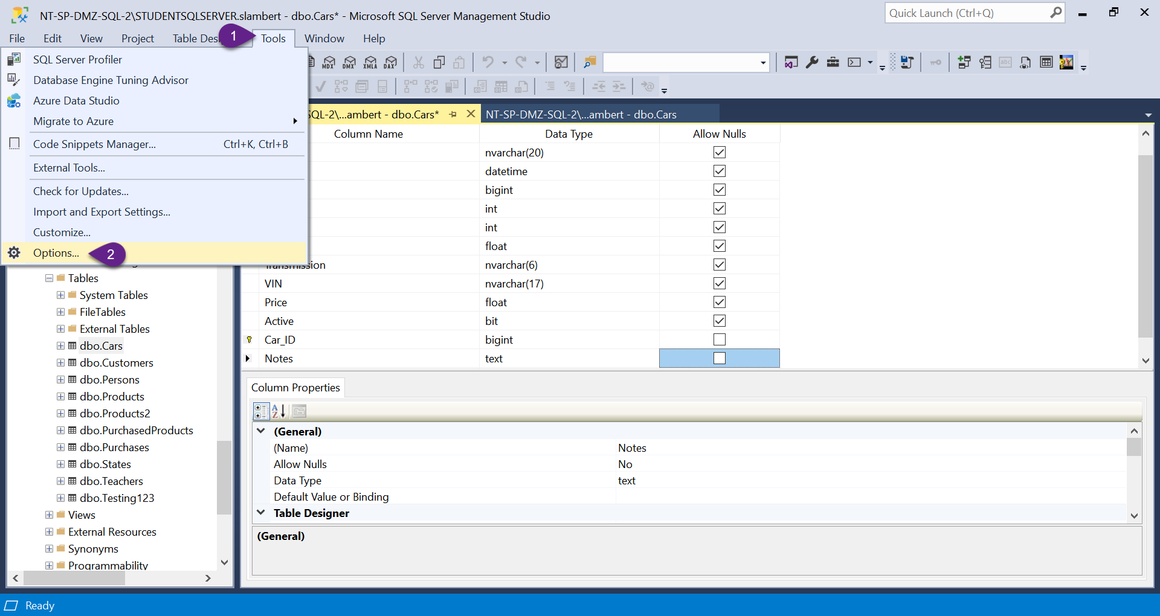

Slide 46
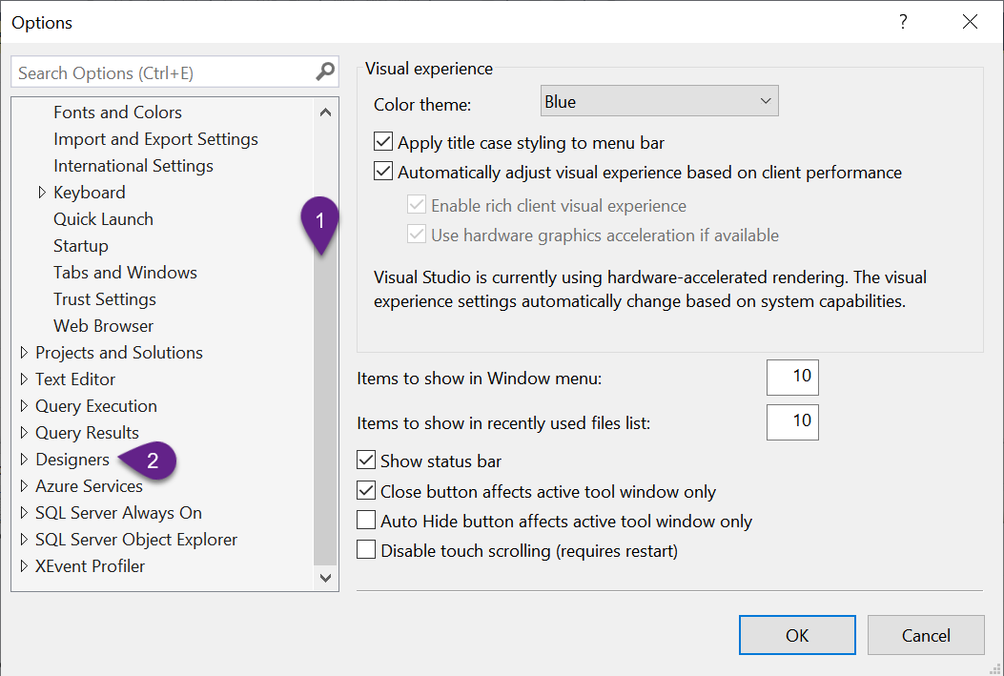

Slide 47
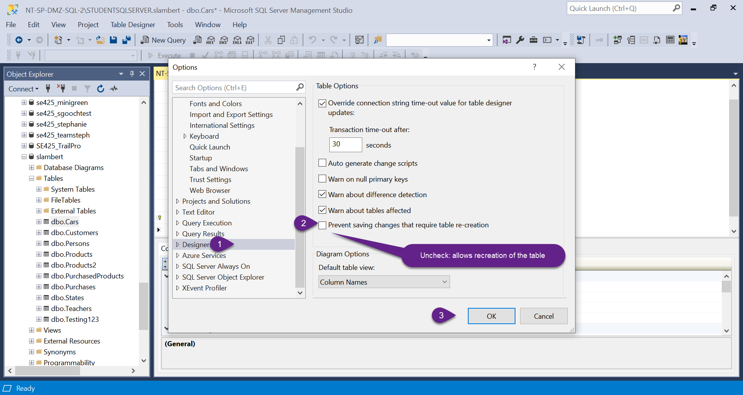

Slide 48
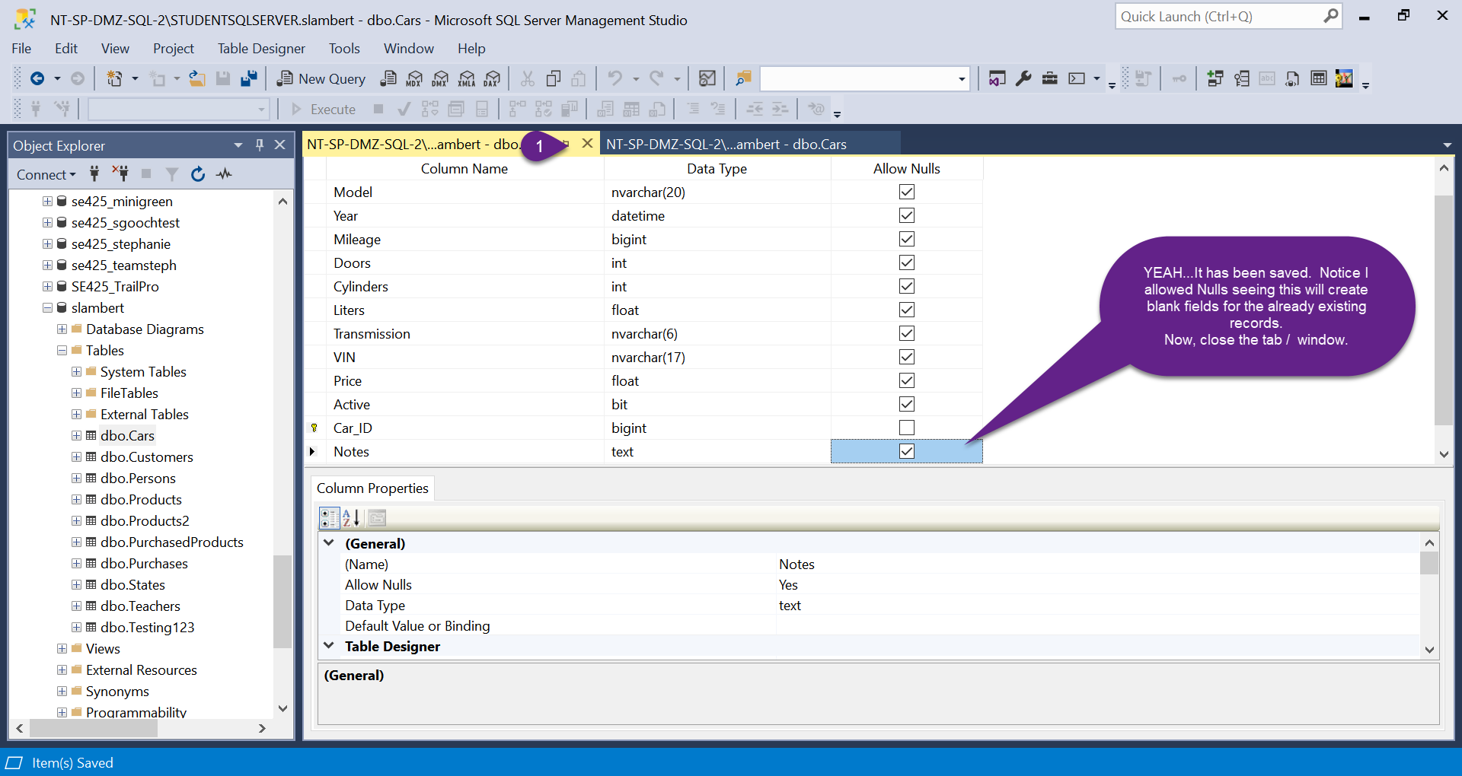

Slide 49
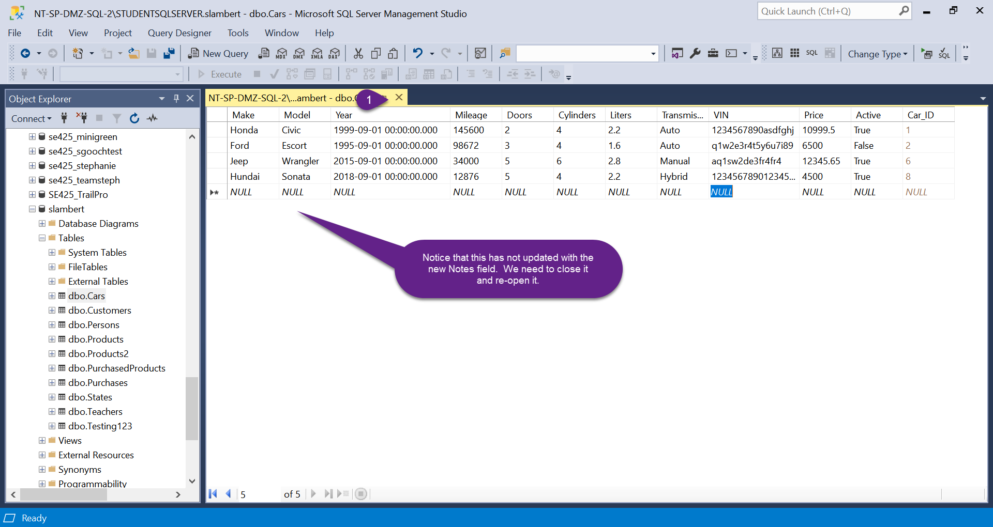

Slide 50


Slide 51
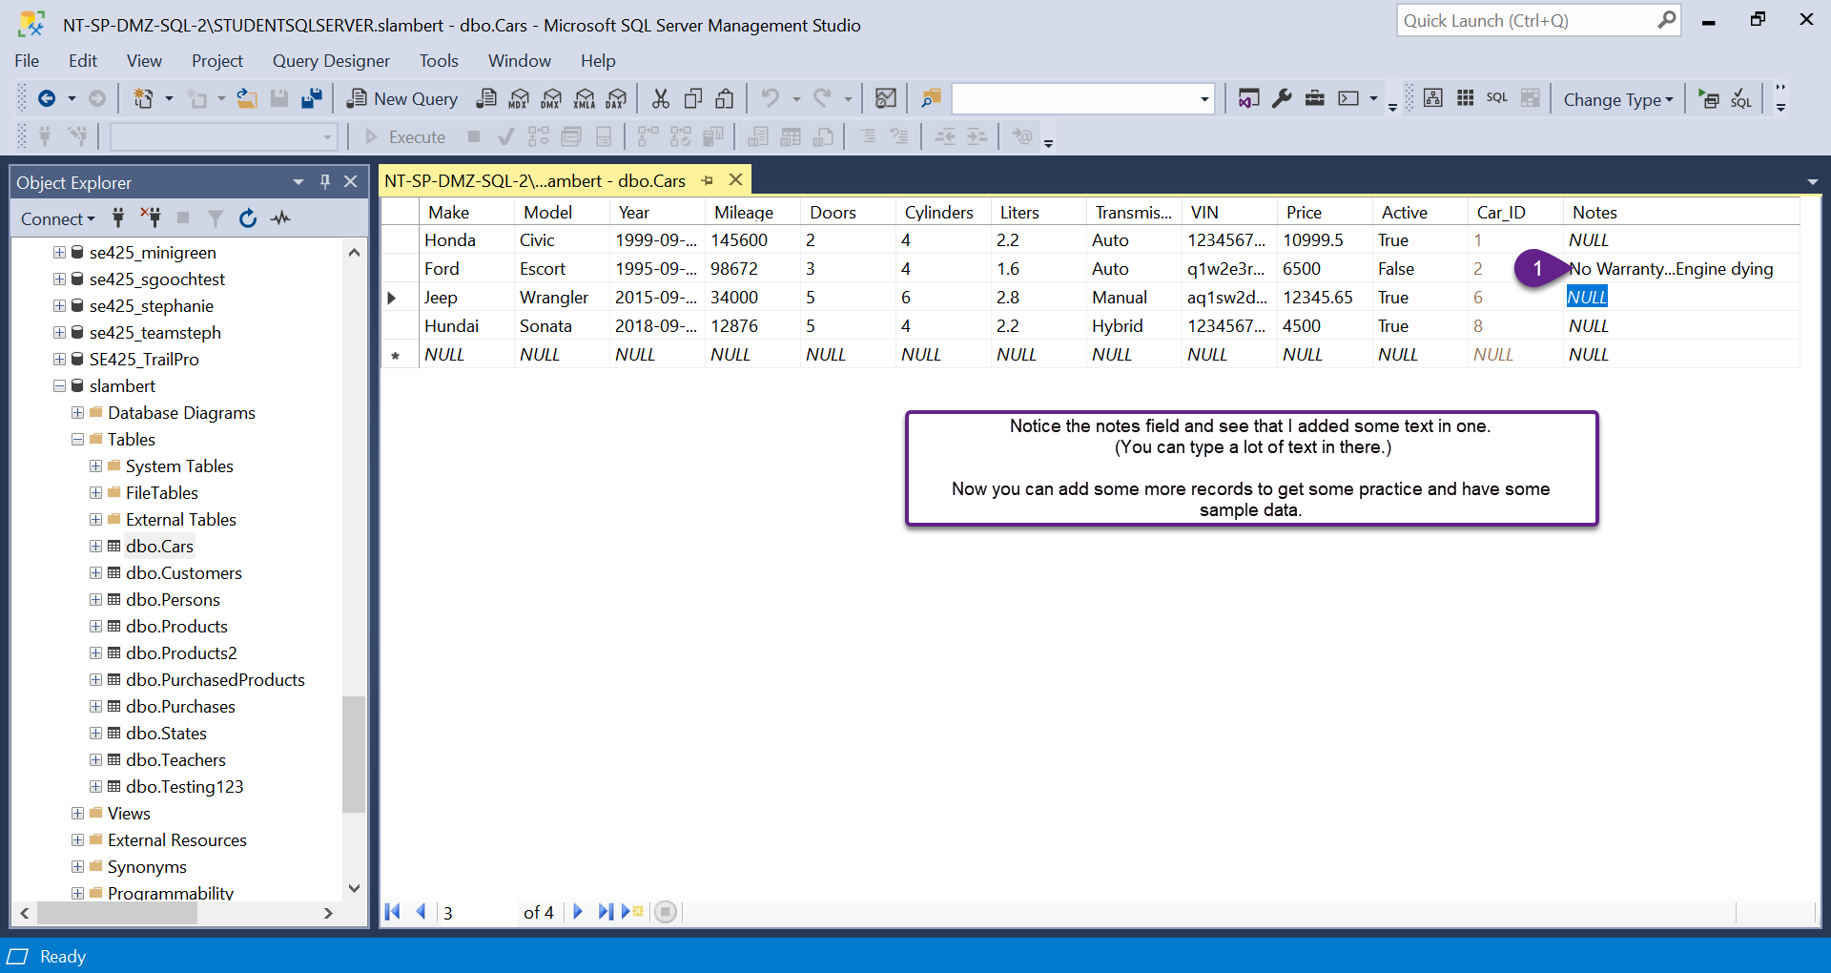

Slide 52
